Slide 1
Linux Architecture
In a Nutshell

Slide 2
Quick Schedule Reminder
Final project and end of year class schedule:
Nov 30th - Class 14 – “Linux Architecture”, final project first draft due
Dec 7^{th -} Class 15 – Final project work session and last draft due
Dec 14th - Last day of finals, no class. Final project due

Slide 3
Linux Architecture
In a Nutshell

Slide 4
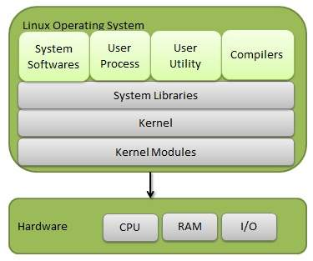
The Linux Operating System:

Slide 5
The Linux Kernel – What does it do?
Abstracts the server at a high level
Does an application need to know what storage path to take or how to address a storage device? Total overkill!
Acts as a resource manager
Several programs running at the same time all get a fair share of system resources – CPU time, memory, disk IO, etc.
Maintains system integrity
Does this software need direct access to the system physical memory? Definitely not.
Is a process running under user A allowed to view the memory contents of a process being run by user B? Definitely not!

Slide 6
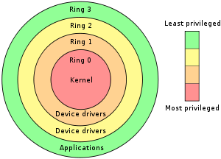
Ring system of privilege levels:

Slide 7
System calls:
Process A - “I want to suspend everyone but my own IO to the disk for five seconds while I write this file.”
Kernel: “Ah, not so fast! Let me check to see if you have the rights to do that!”
Allowing any process to have direct access to things that affect the entire system – like suspending the ability of every other process to write to a disk – is a bad idea.
The kernel takes a request – a ”system call” – to suspend disk IO. It checks to see if the process has the permission to do just that. If it does, the kernel will suspend IO access to the disk on the process’ behalf.

Slide 8
System calls:
Traditional system call categories or groups:
Process management
Signals – nohup, kill, timers, etc
Files – open, close, read, write, file status
Directories – creating, deleting, renaming, linking
Protection mechanisms – reading and changing UIDs / GIDs
Timers – Timer functions, timer related statistical info

Slide 9
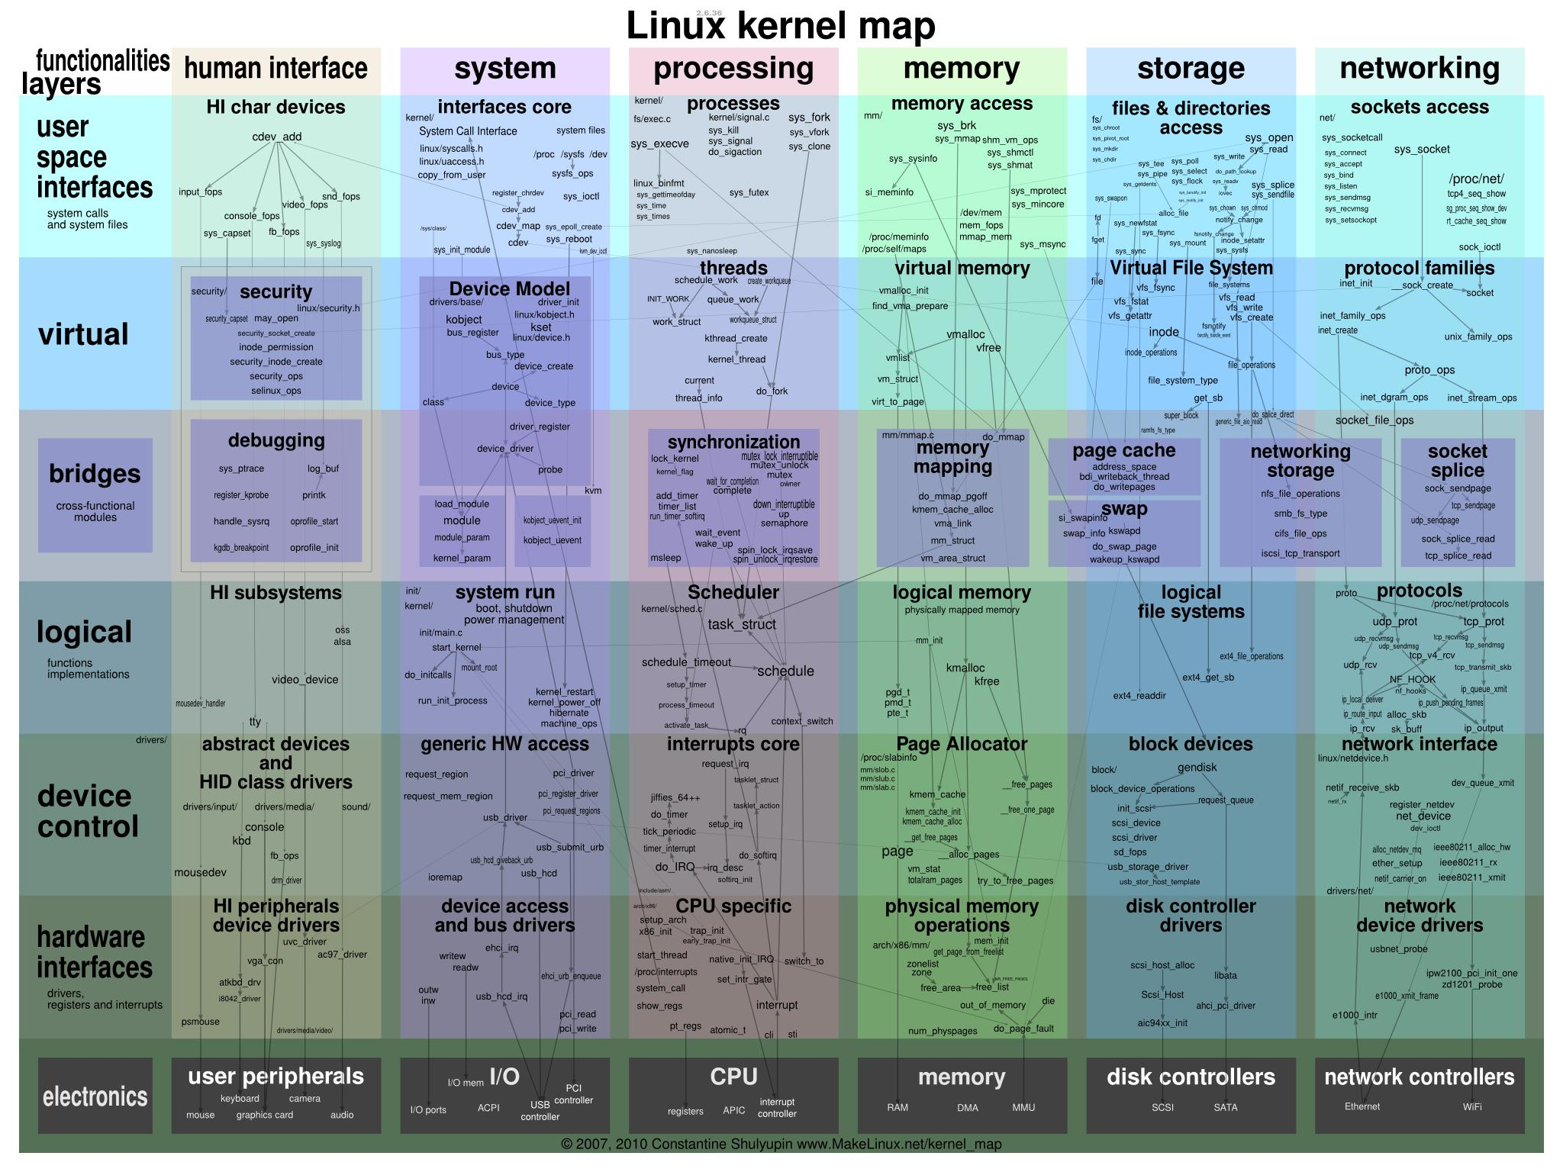
The Linux Kernel – A Comprehensive Overview

Slide 10
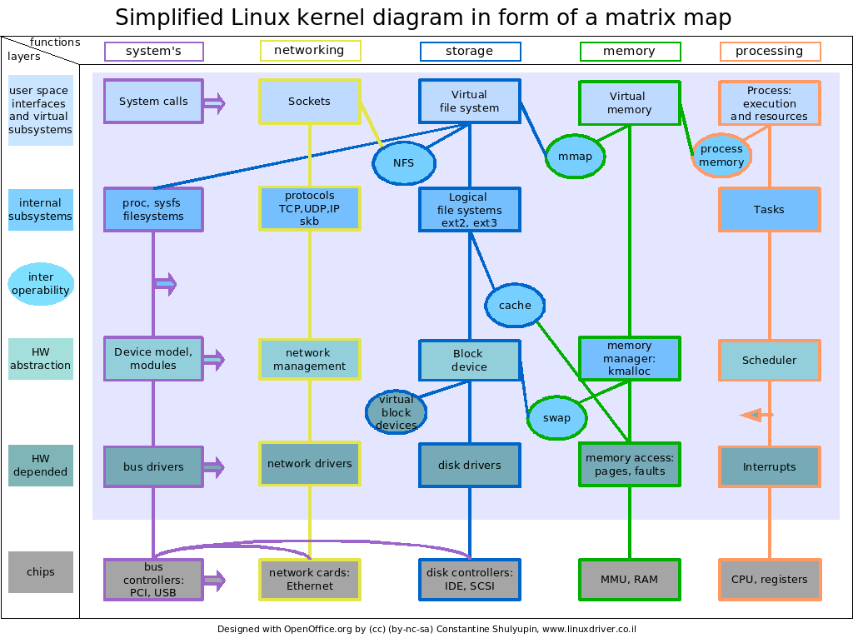
The Linux Kernel – A Simplified Overview

Slide 11
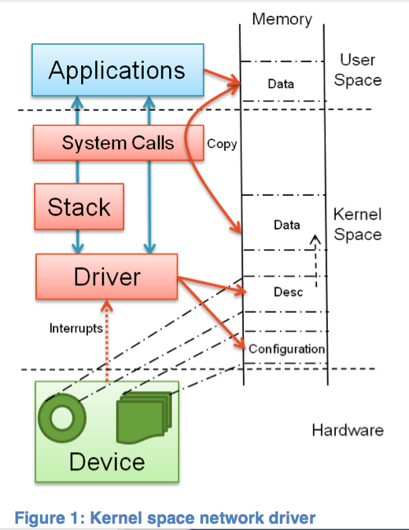
The divide between userland and the kernel:

Slide 12
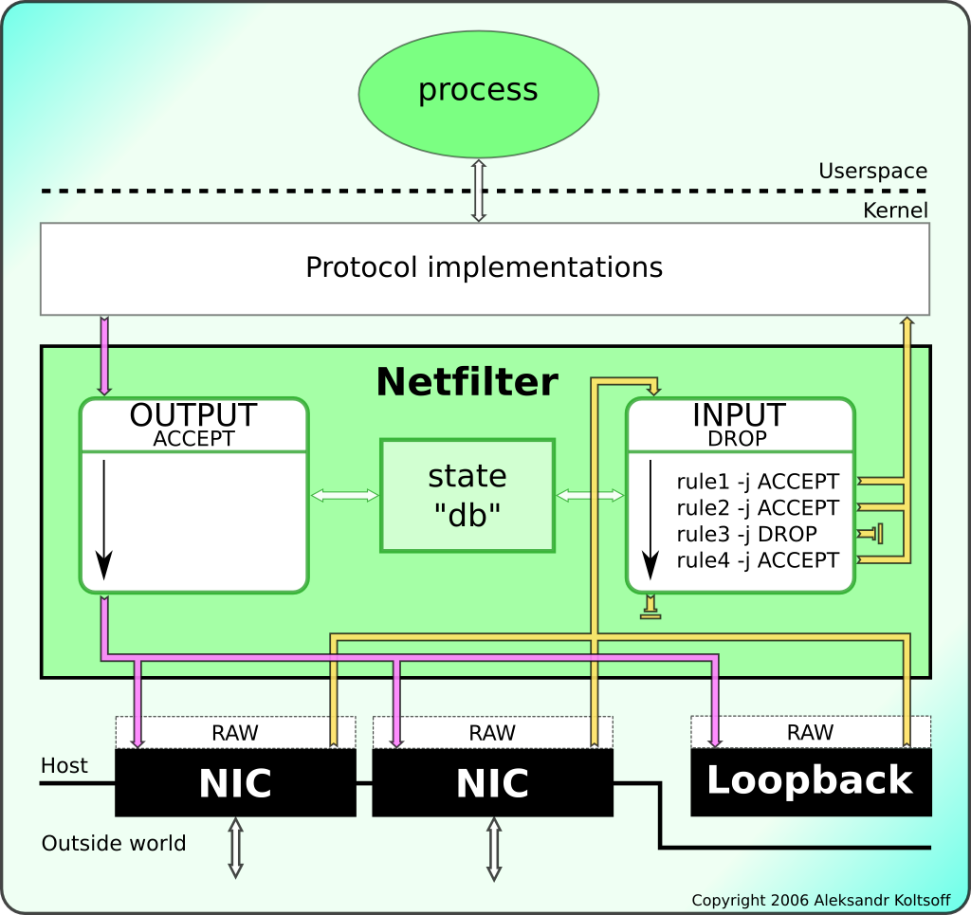
The divide between userland and the kernel:

Slide 13
The End

